Slide 1

PCC ASCEND!

Slide 2
Solar-Powered Payload
Alfredo Gonzalez

Slide 3

Continuous Power Via Photovoltaic Cells
Overview
Battery Powered Results
Fall semester
  Frame design prototyping
  Measurables and plausibility
  Execution and results
Spring semester
  P3 Solar cooperation and design changes
  Proof of concept
  Results
Future
  ASCEND-produced photovoltaic cells

Slide 4
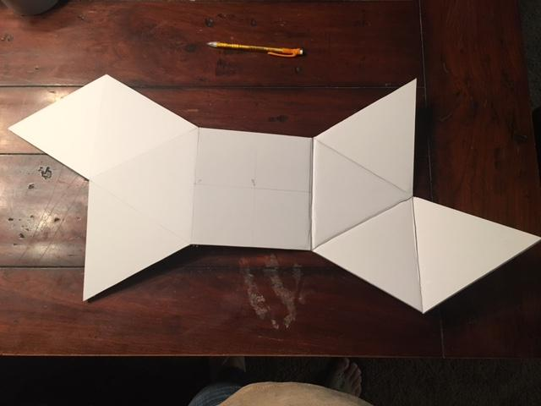
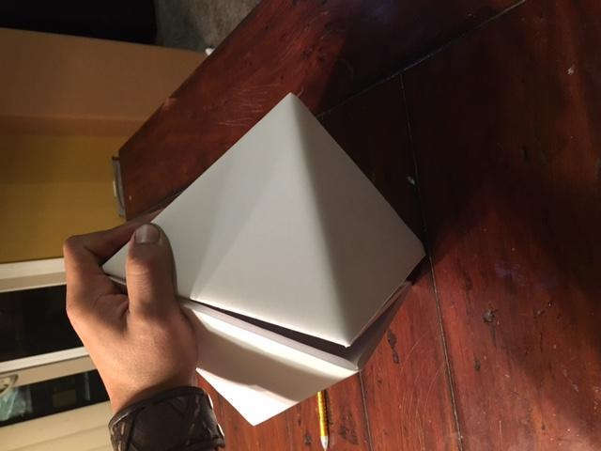
Fall Semester: Frame
Battery Powered Results
One piece of foam poster board
One photocell per face to measure light on every surface simultaneously

Slide 5
Fall Semester: Measurables
Battery Powered Results
P=IV
  Minimum power calculated with minimum requirements for Arduino
P=lux * surface area / luminous efficacy
  Luminous efficacy depends on many variables
  Average efficacy from sunlight is 120 lumens/watt
By calculating lux, we can theorize power output

Slide 6
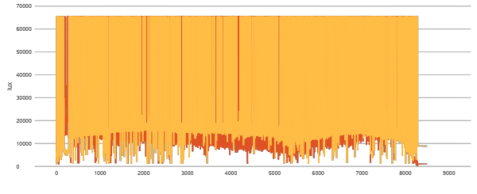
Fall Semester: Results
Battery Powered Results

Slide 7
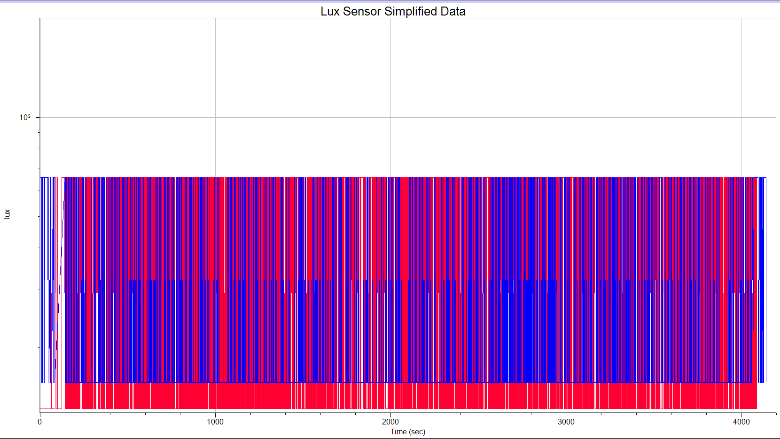
Simplified
Battery Powered Results

Slide 8
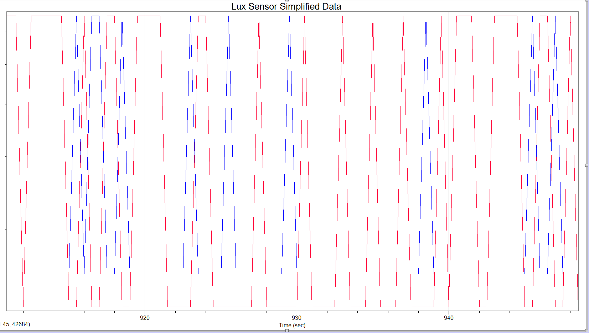
Zoom on Simplified Data
Battery Powered Results

Slide 9
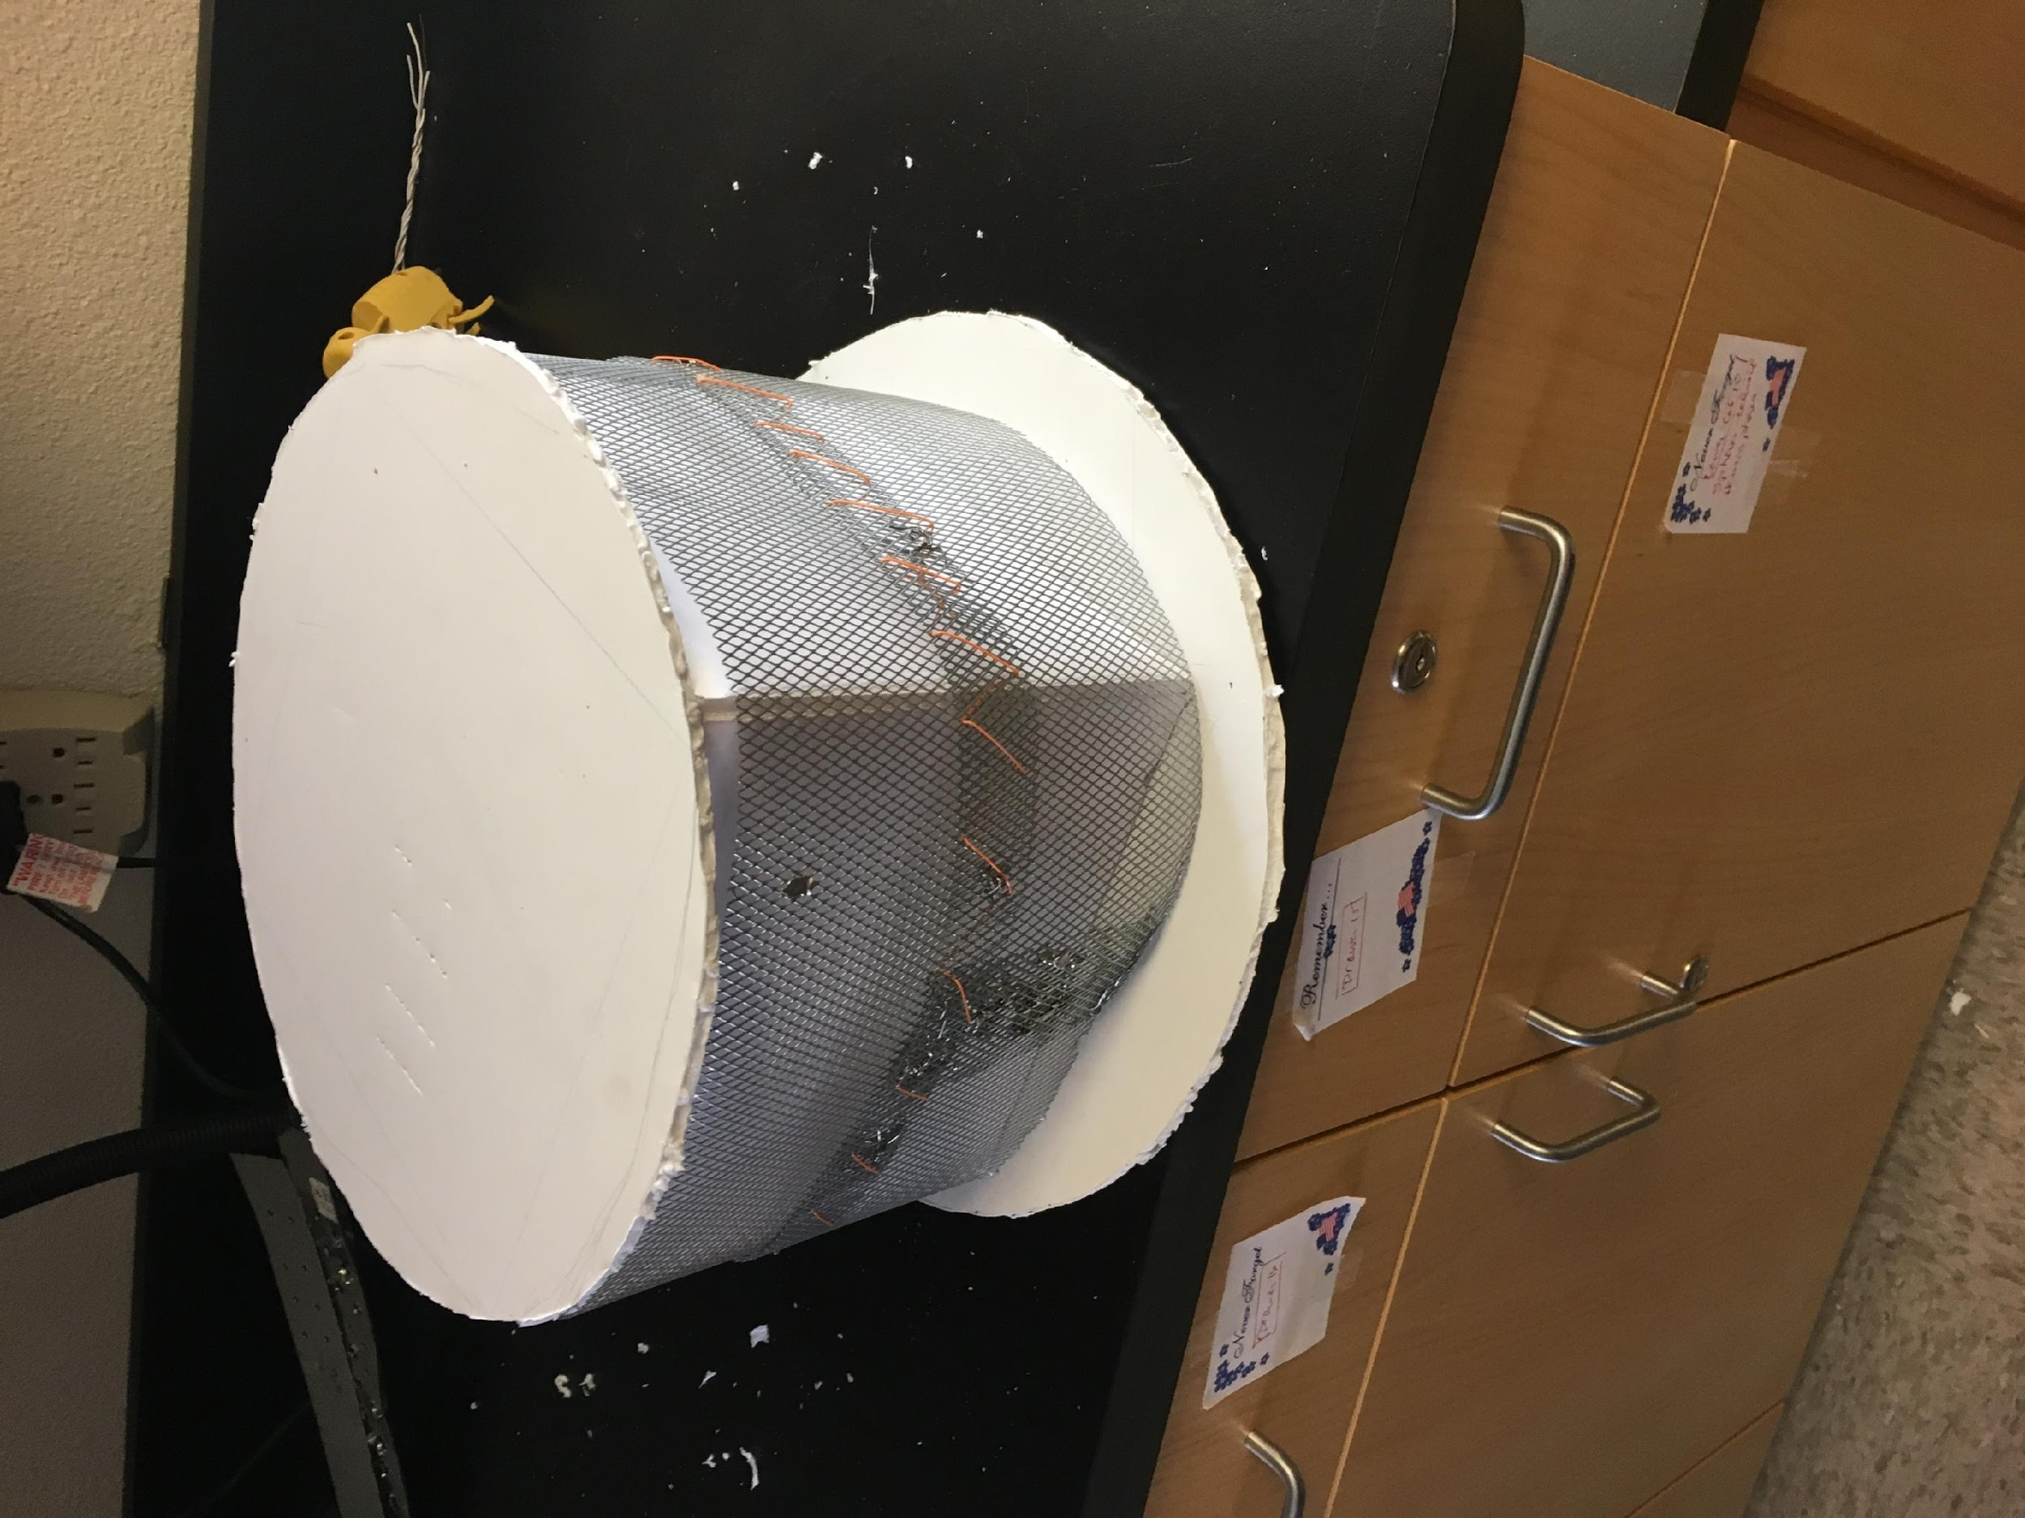
Spring Semester: P3 Solar Cooperation
Battery Powered Results
Partnership with P3 Solar
  Donated a customized solar array to provide power throughout flight
  Design constraints to allow efficient application of panels

Slide 10
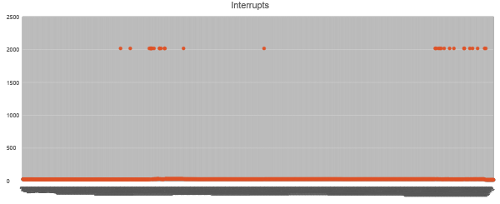
Spring Semester: Results
Battery Powered Results

Slide 11
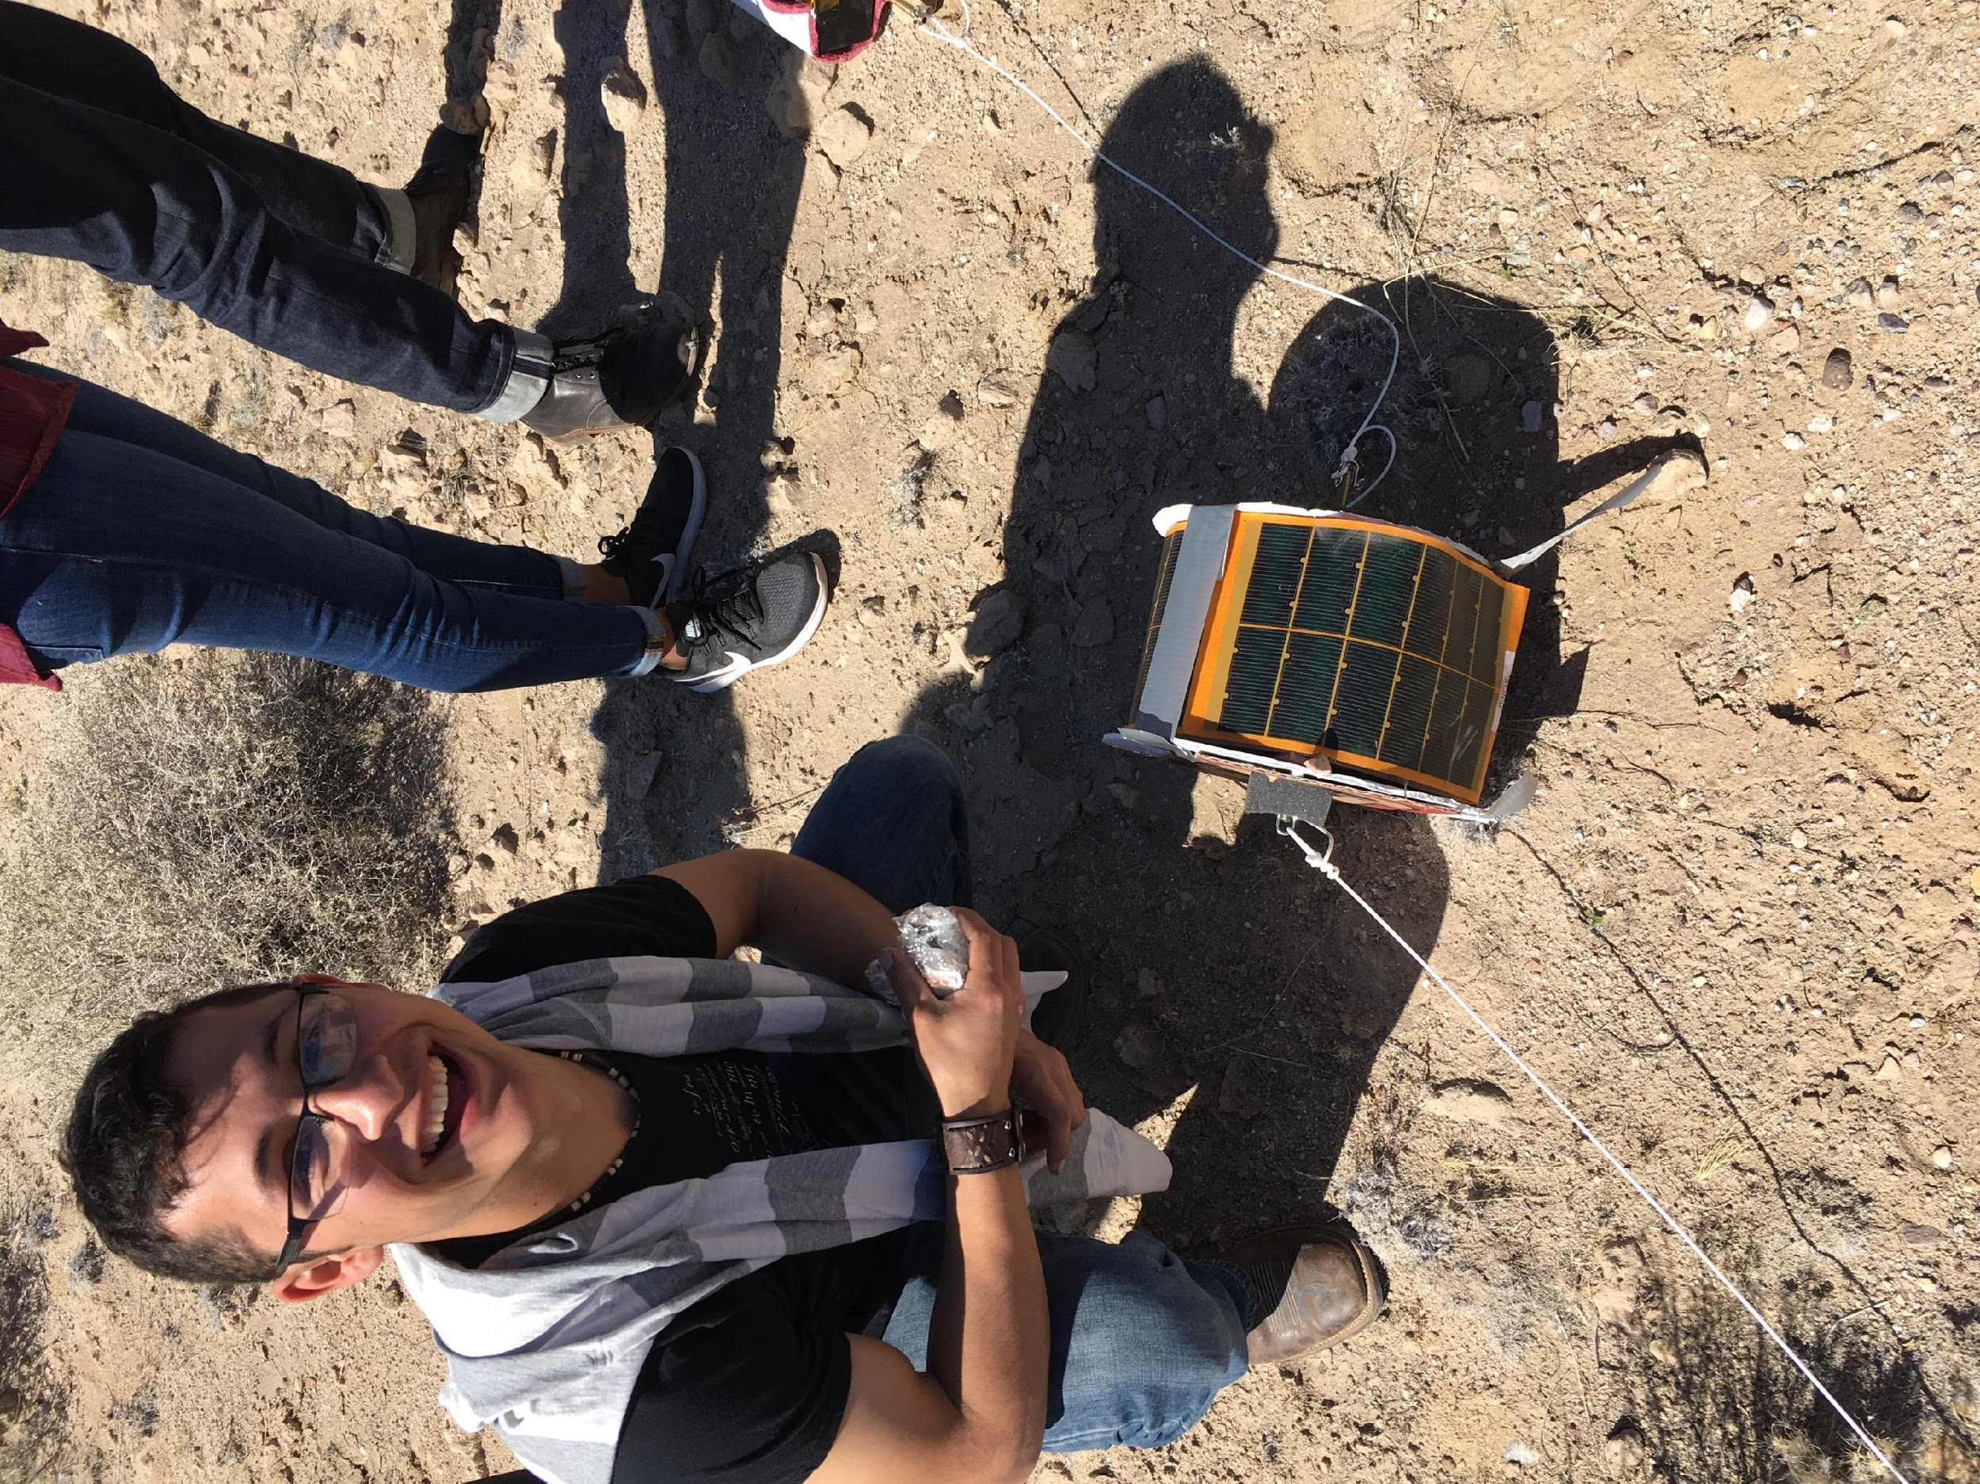
Future
Proper regressions for lux sensor data
Production of photovoltaic cells in lab
Measurable current and voltage in circuit
Efficiency calculations
  Power to weight
  Power to cost

Slide 12
II. Dual BME Sensors
Daniel Elias

Slide 13
The purpose of two sensors was to ensure data was captured and measure any differences in data collection
A Solar Powered BME
An experimental power source
An external power source
Will it get the continuous power needed to gather data?
A Battery Powered BME
A tested and true method
Housed internally
Predictable results

Slide 14
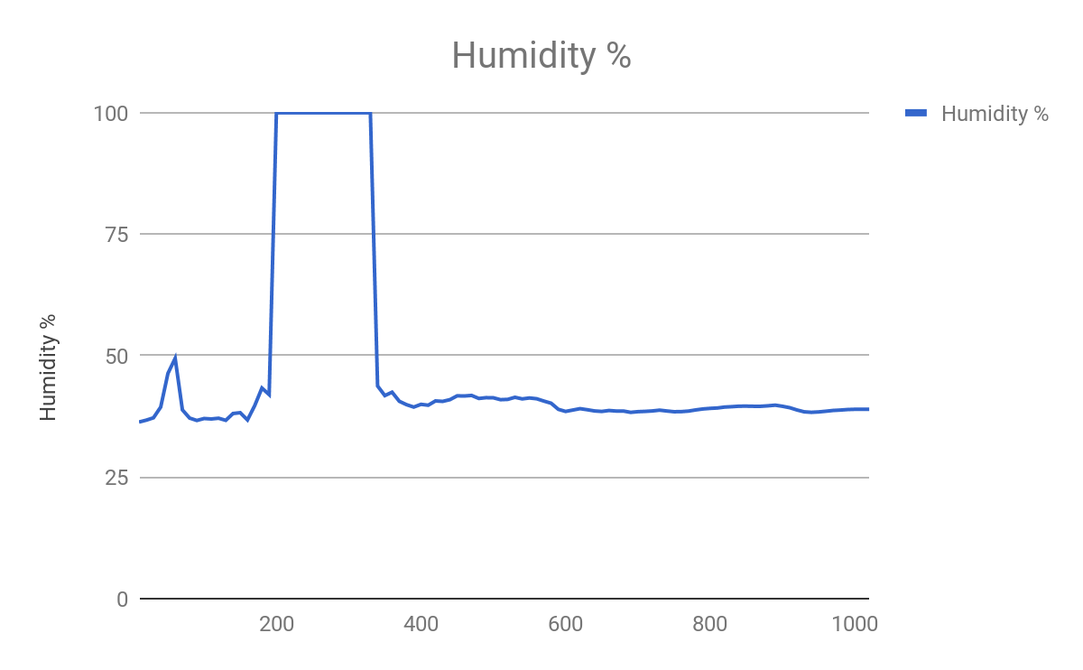
Battery Powered Results

Slide 15
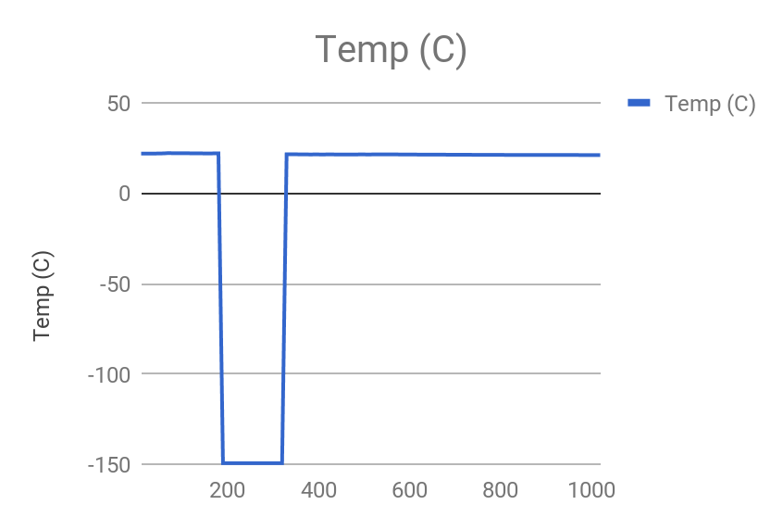
Battery Powered Results

Slide 16
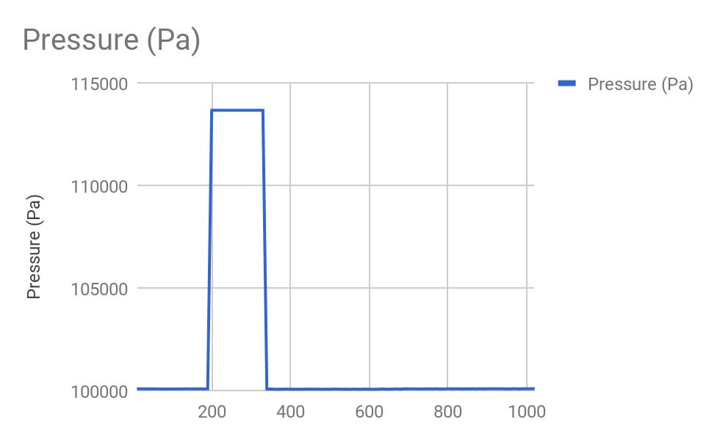
Battery Powered Results

Slide 17
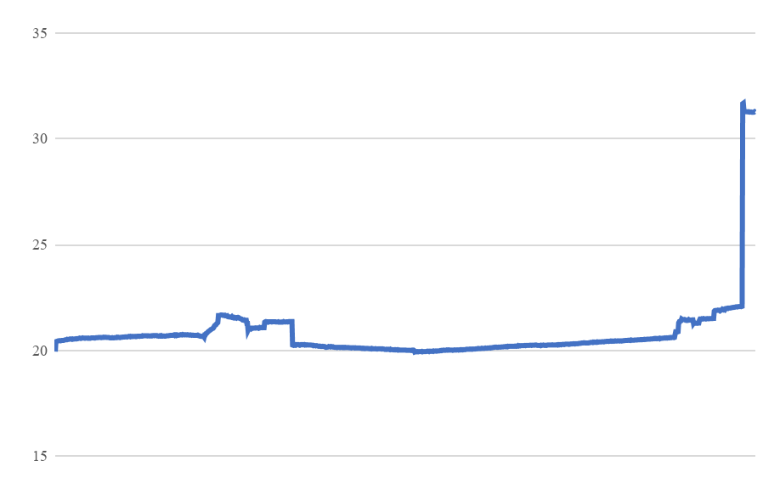
Solar Powered Results

Slide 18
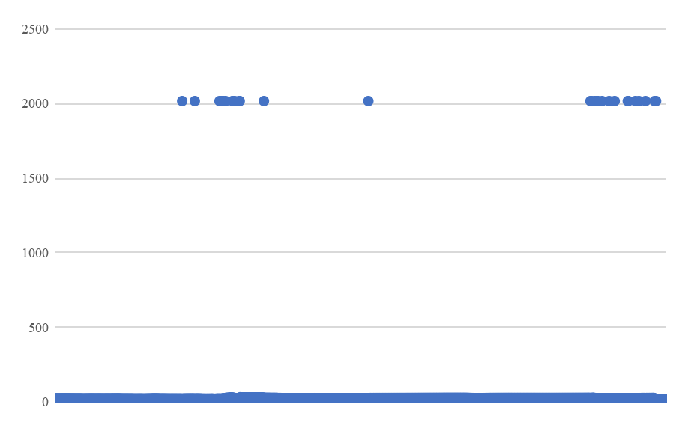
Solar Powered Results

Slide 19
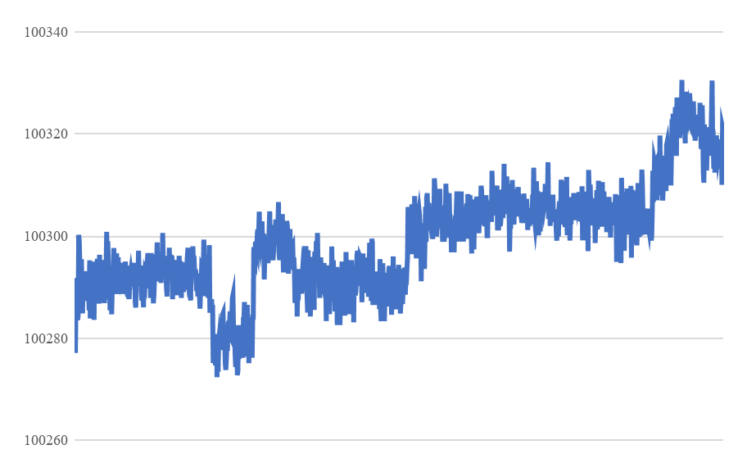
Solar Powered Results

Slide 20
Results
The final results of both BME sensors shows that neither were perfect.
Minor interrupts in one, a major interrupt in the other
Was it reliable?

Slide 21
III. Effect of High-Altitude Flight on the Molecular Structure of Solids
Jacob D’Amour

Slide 22
3D Printed Cubes
Two cubes were 3D printed.
  Control and Test
Test cube successfully recovered from flight.
Analysis of structure revealed differences.
Notes:
At first I had to get the buzzer to make sound for one beep per second, with the right schematics and the right programing to the Arduino Uno.
Then, I had to set the timer to make it to where i can hear it better. (At this point I decided to use the Mini Metal Speaker w/ Wires( - 8 ohm 0.5W), instead of the buzzer, because the sound was clearer.)
3.5 Kilohertz (KHz) or 3500 Hertz and Timed at 100 milliseconds for each delay.
I wanted to know if I could make the speaker beep a song.
I tried many different songs to see if they were compatible to the arduino.
The one that I liked best was the Mario Theme Song.

Slide 23
Future Work
The potential to design materials better suited for high-altitude flight is being investigated.
Notes:
At first I had to get the buzzer to make sound for one beep per second, with the right schematics and the right programing to the Arduino Uno.
Then, I had to set the timer to make it to where i can hear it better. (At this point I decided to use the Mini Metal Speaker w/ Wires( - 8 ohm 0.5W), instead of the buzzer, because the sound was clearer.)
3.5 Kilohertz (KHz) or 3500 Hertz and Timed at 100 milliseconds for each delay.
I wanted to know if I could make the speaker beep a song.
I tried many different songs to see if they were compatible to the arduino.
The one that I liked best was the Mario Theme Song.

Slide 24
IV. E.A.R.S. - External Auditory Retrieval System
Dreah Gray, Alexis Range

Slide 25
E.A.R.S. (External Auditory Retrieval System)
Sound
Setting Time
3.5 Kilohertz (KHz) or 3500 Hertz and Timed at 100 milliseconds for each delay
Songs
Notes:
At first I had to get the buzzer to make sound for one beep per second, with the right schematics and the right programing to the Arduino Uno.
Then, I had to set the timer to make it to where i can hear it better. (At this point I decided to use the Mini Metal Speaker w/ Wires( - 8 ohm 0.5W), instead of the buzzer, because the sound was clearer.)
3.5 Kilohertz (KHz) or 3500 Hertz and Timed at 100 milliseconds for each delay.
I wanted to know if I could make the speaker beep a song.
I tried many different songs to see if they were compatible to the arduino.
The one that I liked best was the Mario Theme Song.

Slide 26

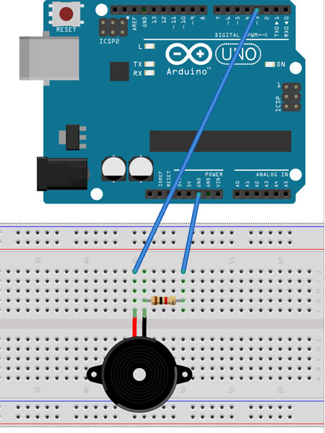

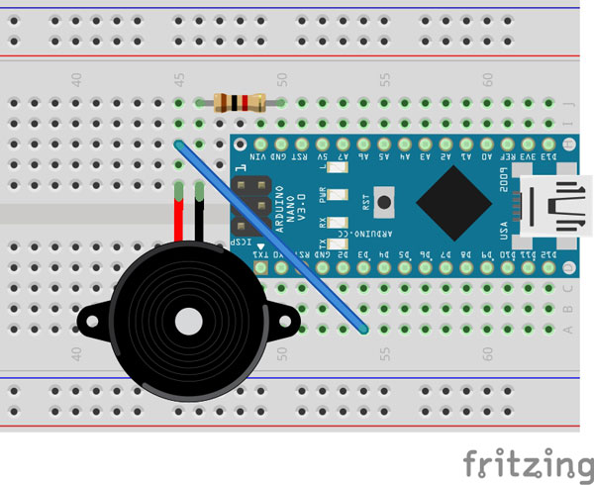
E.A.R.S. (External Auditory Retrieval System)
Arduino Uno
The Mario Theme Song
Arduino Nano
Notes:
After programing and the right schematics, I made the Speaker beep the Mario Theme Song.
After getting the sound to work correctly on the Arduino Uno I decided to see if I could get it to work on the Arduino Nano, for weight purposes.
After, several failed attempts of trying to get the sound to work on the Nano, I decided that I would use the Uno.

Slide 27
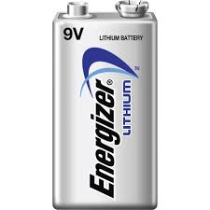
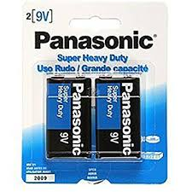
Flight for E.A.R.S.
Final Check
Panasonic 9-Volt Alkaline Battery
2 hours
Energizer 9-Volt Lithium Battery
Notes:
The day before the flight for ears I did a final check on it and everything seemed to be in place for flight.
I hooked the Arduino Board up to a Panasonic 9-volt Alkaline battery for testing.
I set it to go off after 2 hours, that way it wouldn’t waste any of the battery.
Right before the flight I hooked Ears up to a Energizer 9-volt Lithium Battery.

Slide 28
Results for E.A.R.S.
On retrieval of payload (no sound)
Investigation
The problem was the Energizer 9-Volt Lithium Battery
Why did not work with the Lithium battery?
Notes:
When we retrieved the payload I couldn’t hear EARS.
When I looked at the schematics and programing everything was fine.
The problem was the Energizer 9-Volt Lithium Battery.
But why?

Slide 29
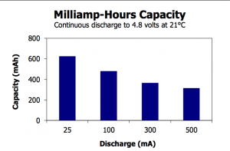
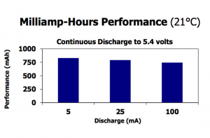
Research
Batteries have different energy capacities and max output currents.
From my research the Lithium battery should last longer than the Alkaline battery.
Alkaline 9-Volt Battery
Lithium 9-Volt Battery
9V (6LR61) Life / Capacity Graph – Courtesy of Energizer
9V (LA552) Life / Capacity Graph – Courtesy of Energizer
Notes:
I researched this and I didn’t see any other people having problems with a Lithium Battery.
Though, batteries have different energy capacities and max output currents.
From my research the Lithium battery should last longer than the Alkaline battery.
What I concluded from my research is either the battery had no charge or the Lithium battery was not compatible with the Arduino Uno.

Slide 30
What’s Next for E.A.R.S.
Louder
Arduino Nano for Weight
Multiple checks on battery or maybe a different source of energy
Notes:
For the next payload I plan on making the sound louder.
I, also, want to figure out how to get the sound for Arduino Nano, for a lighter payload.
I want to do multiple battery checks and see if a charged lithium battery is better than an alkaline, to see if the lithium battery is an okay source of power. Or maybe use a whole new power source.

